Slide 1



UNIT IV.
STYLE A WEBSITE WITH CSS
PREPARED BY: JOANA MARIE C. TOLENTINO

Slide 2




Learning Objectives
1.
2.
style elements using inline CSS to enhance the appearance of a web page; and
develop a visually appealing and well-structured web page using an internal style sheet.

Slide 3
UNIT TOPICS
01
02
IMPROVING THE APPEARANCE OF YOUR WEB PAGE
DESIGNING A WEBSITE USING INTERNAL STYLE SHEET
04
05

Slide 4


Improving the Appearance of your Web Page

Slide 5
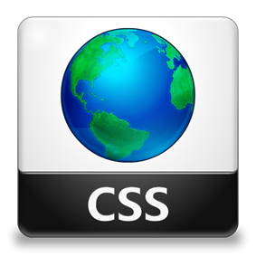

What is a Cascading Style Sheet?
Cascading Style Sheets, or CSS, is a scripting language used to characterize the layout of an HTML document. CSS lets web developers determine how HTML components are to be viewed on various platforms and screen sizes.

Slide 6
CSS Example:
body {
background-color: blue;
}
h1{
color: red
text-align: center;
}

Slide 7
APPLY CSS TO A WEB PAGE

Slide 8
Ways to apply CSS in a webpage
Inline CSS
Internal or Embedded CSS
External CSS
CSS Framework

Slide 9
INLINE CSS

Slide 10
The HTML Style Attribute
•The style attribute can be used to set the style of a specific HTML element.
•The syntax should be like this:
<tagname style=“property:value”>
Example:
<p style="color: blue; font-size: 18px; margin: 10px;">This is a styled paragraph. </p>
Notes:
In this example:
The color property is set to blue, changing the text color.
The font-size property is set to 18px, increasing the text size.
The margin property is set to 10px, adding space around the paragraph.

Slide 11
Inline CSS
•Inline CSS is used for applying style to a particular HTML Tag.
•Least recommended styling method because of the difficulty it brings in managing larger websites.
•Useful for testing and previewing changes

Slide 12
CSS Background Properties
Property | Description
background | Sets all the background properties in one declaration
background-color | Sets the background color of an element
background-image | Sets the background image for an element
background-repeat | Sets how a background image will be repeated
background-attachment | Sets whether a background image is fixed or scrolls with the rest of the page
background-position | Sets the starting position of a background image

Slide 13
CSS background-repeat
background-repeat: repeat;
background-repeat: repeat-x;
background-repeat: repeat-y;
background-repeat: no-repeat;
background-repeat: space;
background-repeat: round;

Slide 14
HTML Background Color
•The background-color property defines the background color for an HTML element.

Slide 15
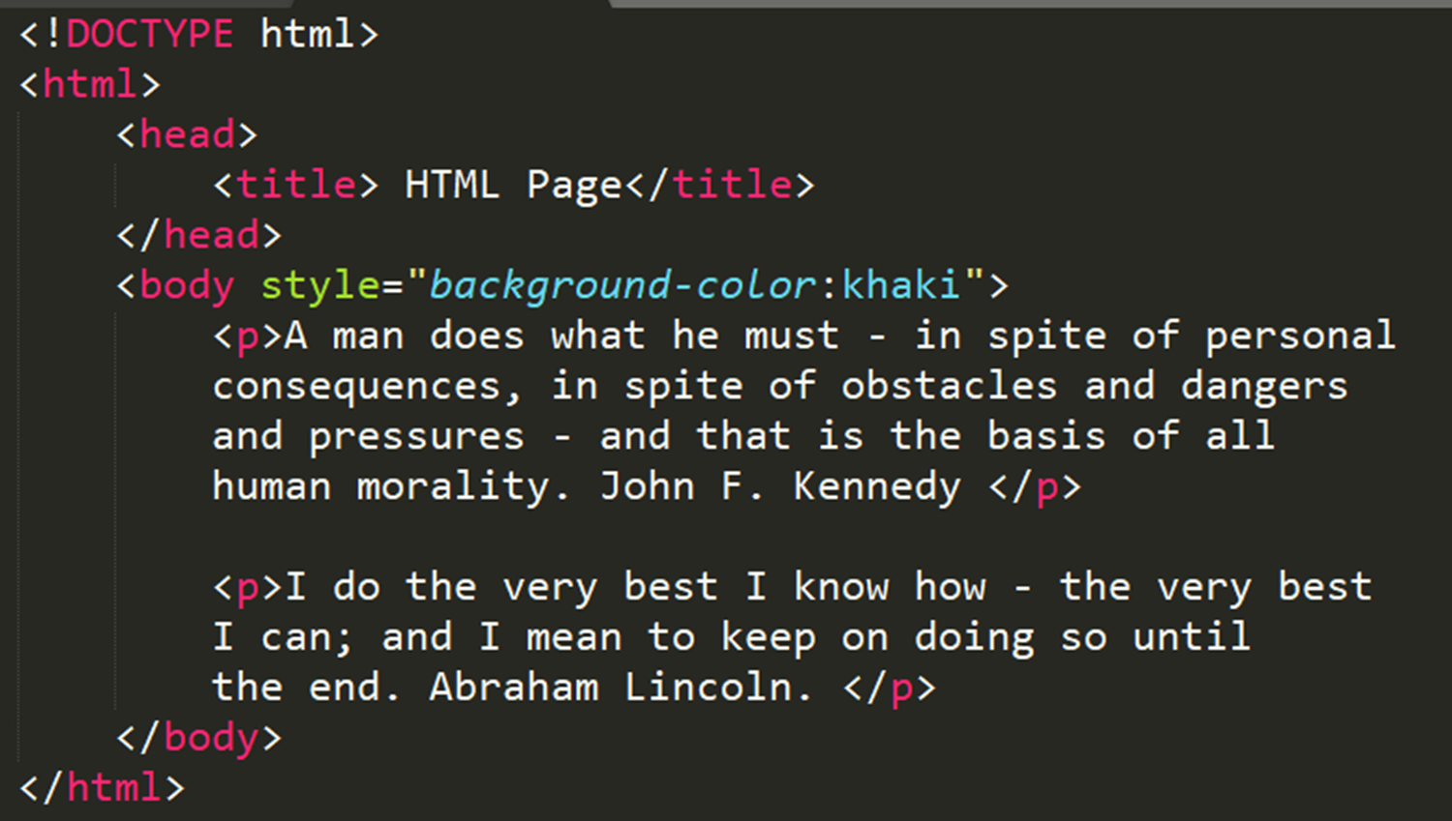

Slide 16
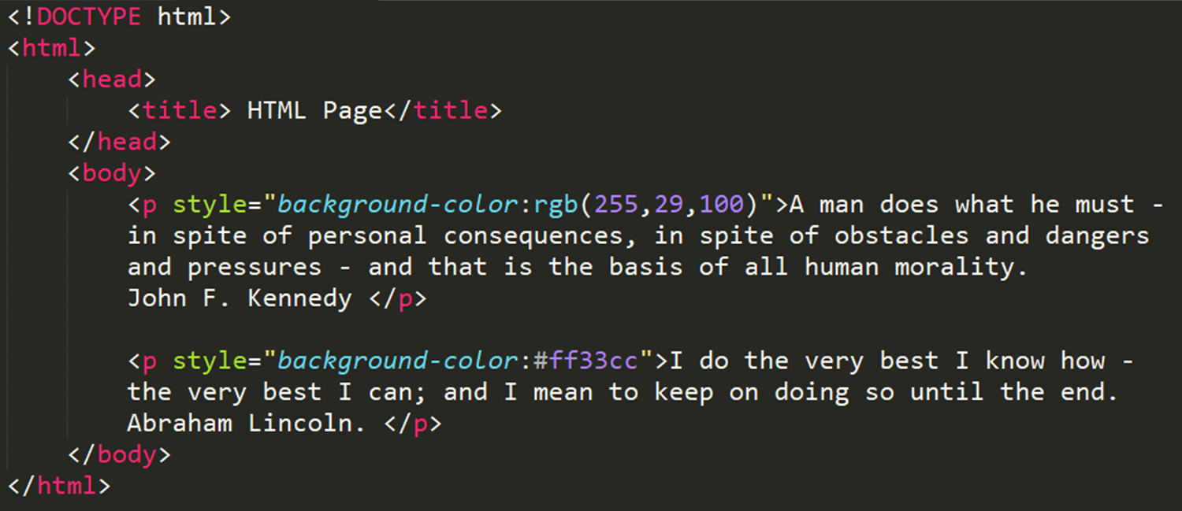

Slide 17
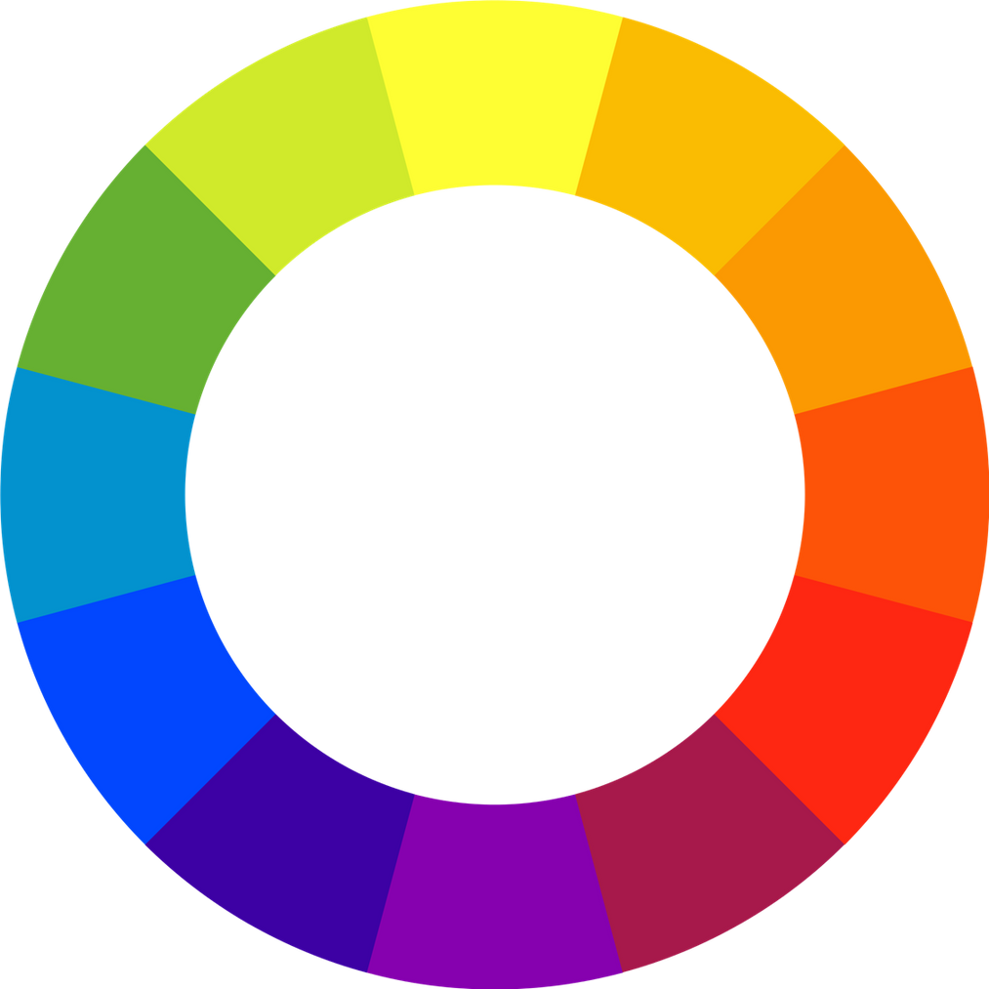
HTML Colors

Slide 18
HTML Colors
•In HTML, a color can be defined by using color names or RGB, Hex and HSL values.
•Color Name: tomato
•RGB Value: rgb(255, 99, 71)
•Hex Value: #ff6347
•HSL Value: hsl(9, 100%, 64%)

Slide 19
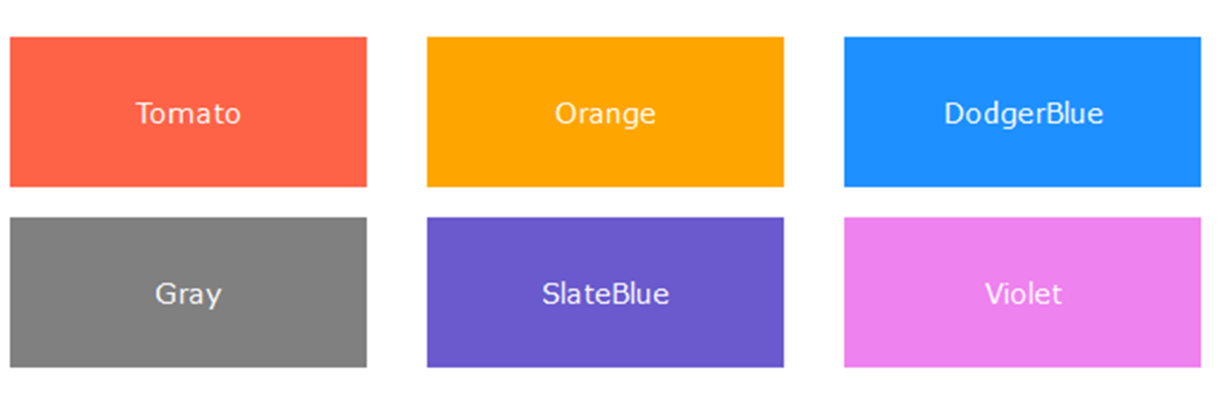
Colors Names
•HTML supports 140 standard color names

Slide 20
RGB Value
•In HTML, a color can be specified as an RGB value using this formula: rgb(red, green, blue)
•Each parameter (red, green, blue) defines the density of the color between 0 and 255.
•For example, rgb(255,255,0) is displayed as red, because red is set to its highest value, and the others are set to 0.

Slide 21
RGB Value
•To display the color black, all colors must be set to 0, like this rgb(0,0,0).
•To display the color white, all colors must be set to 255, like this rgb(255,255,255).

Slide 22
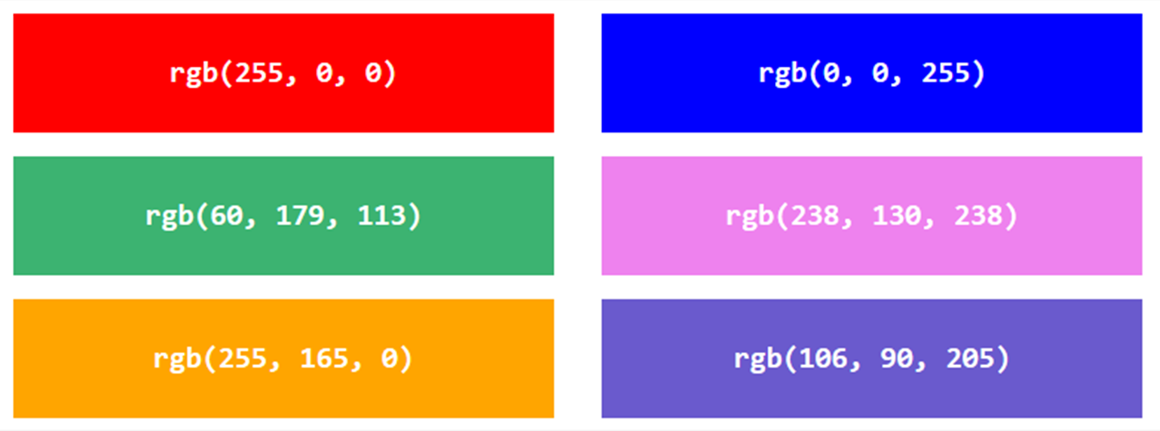
RGB Value

Slide 23
Hex Value
•In HTML, a color can be specified using the hexadecimal value in the form: #rrggbb where rr(red), gg(green) and bb(blue) are hexadecimal values between 00 and ff (same as decimal 0-255).
•For example, #00ffff is displayed as red, because red is set to its highest value (ff) and the others are set to the lowest value (00).

Slide 24
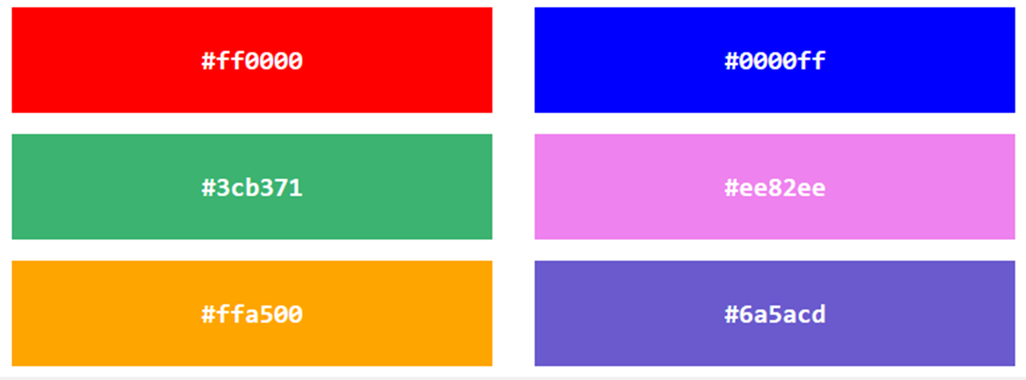
Hex Value

Slide 25
HSL Value
•In HTML, a color can be specified using hue, saturation, and lightness (HSL) in the form: hsl(hue, saturation, lightness).
•Hue is the degree on the color wheel from 0 to 360, 0 is red, 120 is green and 240 is blue.
•Saturation can be described as the intensity of the color, 100% is pure color (no shade of gray), 50% is 50% gray (but you can still see the color), 0% is completely gray (you can no longer see the color).

Slide 26
HSL Value
•Lightness is also a percentage, 0% is black, 50% is neither light or dark, 100% is white.

Slide 27
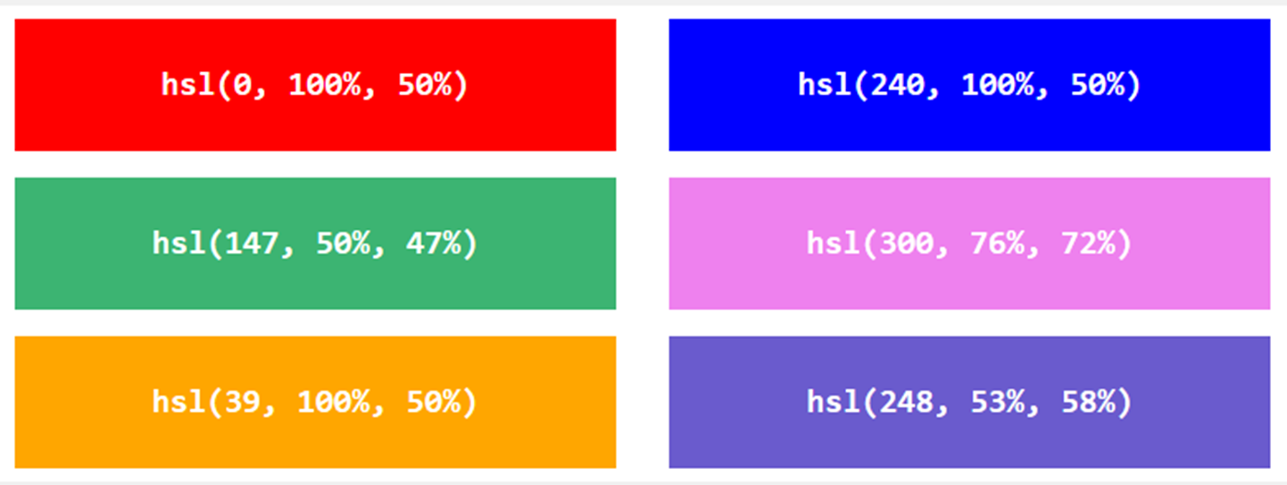
HSL Value

Slide 28
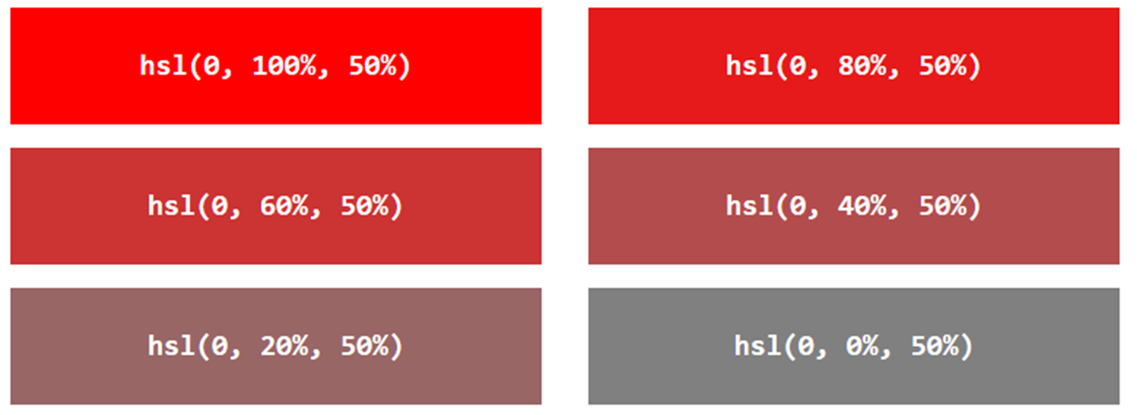
HSL Saturation Effect

Slide 29
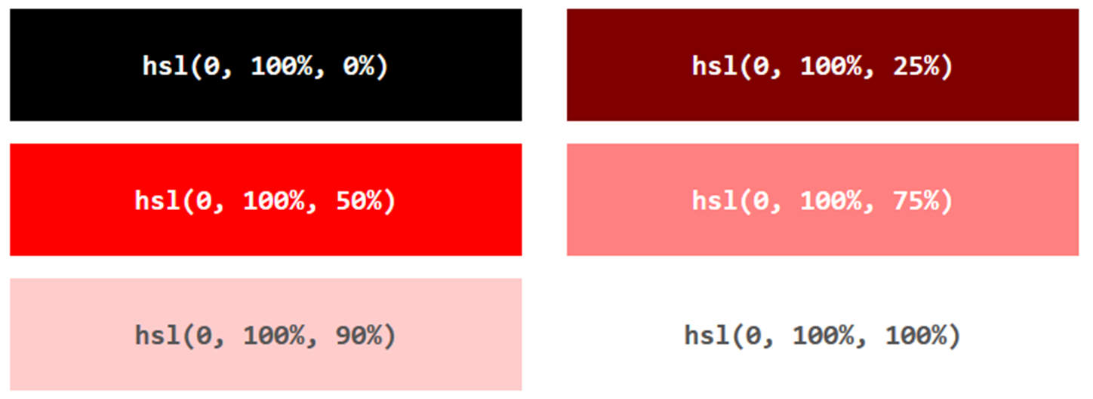
HSL Lightness Effect

Slide 30
Background Image
The background-image property specifies an image to use as the background of an element.
By default, the image is repeated so it covers the entire element.
The background image for a page can be set like this:
<body style = “background-image: url(‘paper.gif’)”>
</body>

Slide 31
Background Image - Repeat Horizontally or Vertically
By default, the background-image property repeats an image both horizontally and vertically.
If the image is repeated only horizontally (repeat-x), the background will look better:
<body style = “background-image: url(‘gradient.png’); background-repeat: repeat-x”> </body>

Slide 32
Background Image - Set position and no-repeat
Showing the image only once is specified by the background-repeat property:
<body style= “background-image: url(‘img_tree.png’);
background-repeat:no-repeat”>
</body>

Slide 33
Background Image - Set position and no-repeat
The position of the image is specified by the background-position property:
<body style = “background-image: url(‘img_tree.png’); background-repeat: no-repeat; background-position: right top”>
</body>

Slide 34
CSS background-repeat
background-repeat: repeat;
background-repeat: repeat-x;
background-repeat: repeat-y;
background-repeat: no-repeat;
background-repeat: space;
background-repeat: round;

Slide 35
Background-Attachment
The background-attachment property sets whether a background image is fixed or scrolls with the rest of the page.
Common Values:
Value | Description
scroll | The background scrolls along with the element. This is default
fixed | The background is fixed with regard to the viewport

Slide 36
HTML Text Color
•The color property defines the text color for an HTML element.

Slide 37
HTML Fonts
•The font-family property defines the fonts to be used for an HTML element.

Slide 38
HTML Text Size
•The font-size property defines the text size for an HTML element.
•The font-size value can be an absolute (pixels) or relative (em) size.

Slide 39
HTML Text Alignment
•The text-align property defines the horizontal text alignment for an HTML element.
•A text can be left or right aligned, centered or justified.

Slide 40
HTML Text Indentation
•The text-indent property is used to specify the indentation of the first line of text.

Slide 41

LABORATORY EXERCISE 6

Slide 42
Instructions
Open Laboratory1.html
Save the contents to a new file named Laboratory5.html
Change the title to Laboratory 5
Change the background-color of the whole web page to “skyblue”.
Change the text color of the heading to rgb(255,255,255)
Change the text color of all bold texts to “Tomato”.
Indent all the first line of the paragraph and set to 40px.
Align text to justify.

Slide 43
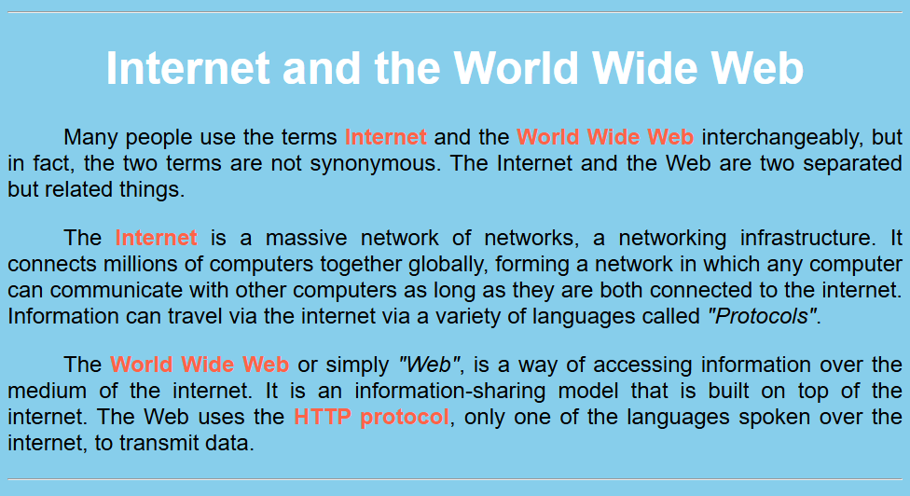
OUTPUT

Slide 44
CSS Text Property
color
Text-align
Text-decoration
Text-transform
Text-indent
Notes:
text-decoration: Adds or removes text decorations.
Values:
none (no decoration)
underline (underlines text)
overline (adds a line above text)
line-through (strikes through text)
blink (deprecated, used for blinking text)
text-transform: Controls the capitalization of text.
Values:
none (default)
uppercase (converts text to uppercase)
lowercase (converts text to lowercase)
capitalize (capitalizes the first letter of each word)
text-indent: Sets the indentation of the first line in a text block.
Values:
Length values: 10px, 20px, 5em, 2rem
Percentage: 10% (relative to container width)
inherit (inherits from parent element)

Slide 45
CSS Font Property
Font-family
Font-style
Font-weight
Font-size

Slide 46
CSS Border Property
border
Border-width
Border-style
Border- color
Border-radius

Slide 47
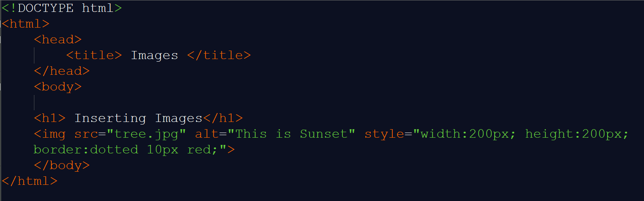
CSS Border Property
border
Border-width
Border-style
Border- color
Border-radius

Slide 48
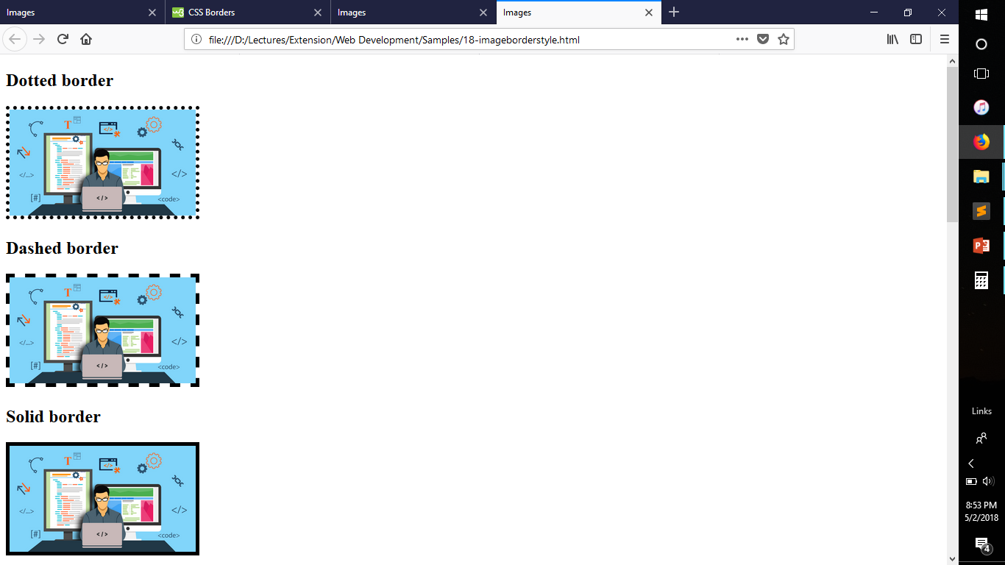
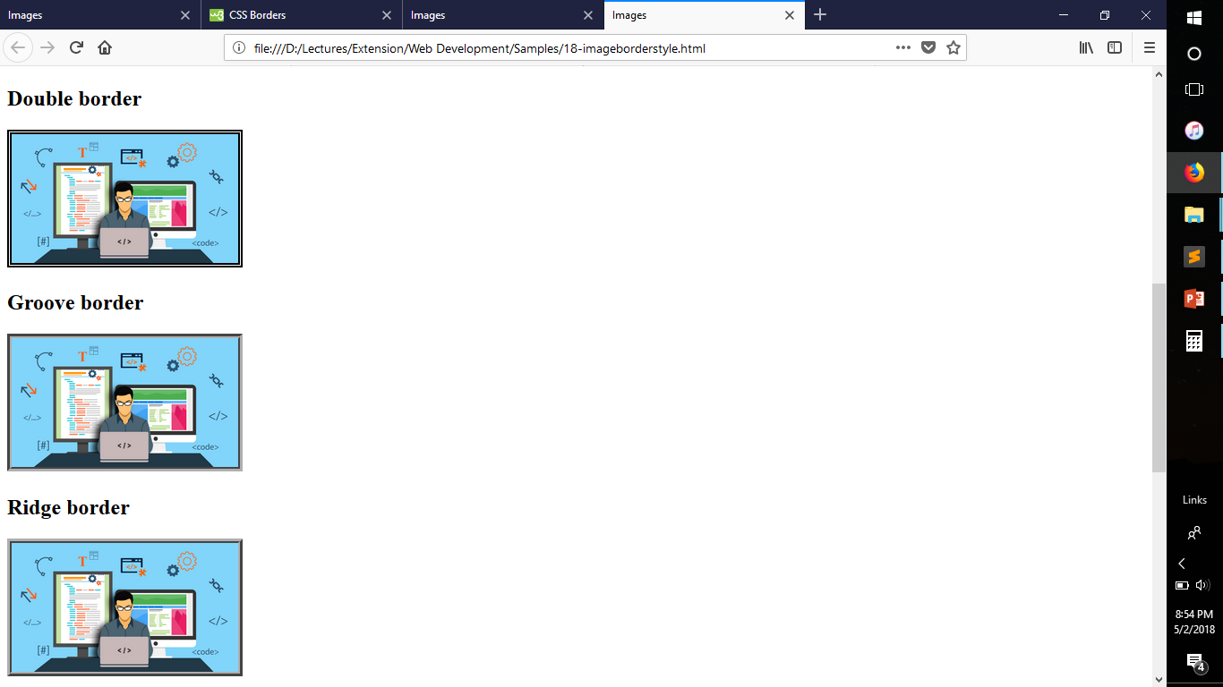
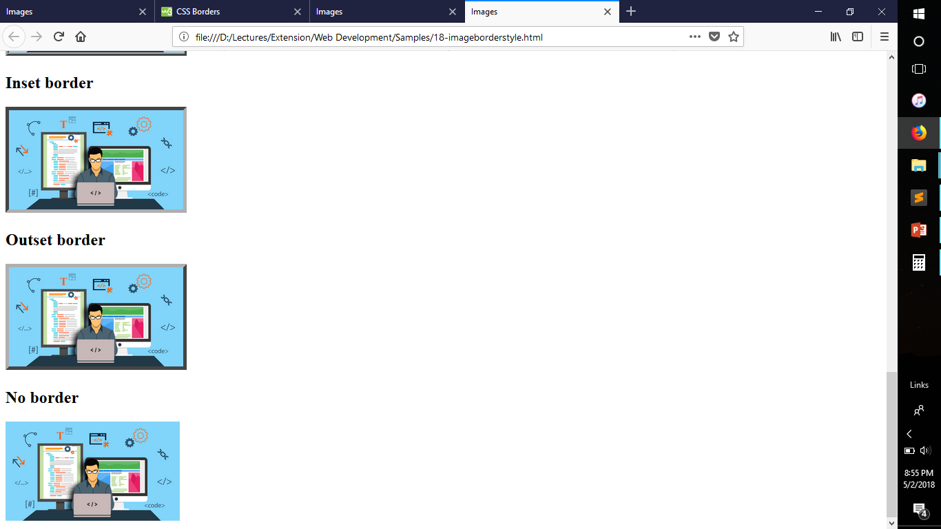
CSS Border Property

Slide 49
CSS Margins
CSS margins are essential for defining the spacing around HTML elements outside their borders.
The "auto" value allows the browser to automatically calculate the optimal margin, which is especially useful for centering elements.
The "length" value enables you to set a fixed margin size using units such as pixels (px), points (pt), or centimeters (cm).

Slide 50
CSS Margins
Additionally, margins can be defined as a percentage (%) of the width of the containing element, providing responsive design capabilities.
The "inherit" value ensures that the margin is inherited from the parent element, maintaining consistency among nested elements.

Slide 51
CSS Padding
CSS padding is a fundamental aspect of web design that allows developers to create space around an element's content, inside its borders.
Notes:
This spacing enhances readability and visual appeal by preventing text or other content from touching the edges. Padding can be adjusted for each side of an element—top, right, bottom, and left—using specific properties such as padding-top, padding-right, padding-bottom, and padding-left.

Slide 52
CSS Height/Width
These properties specifically control the size of the space inside an element's padding, border, and margin, allowing developers to dictate how much space the content occupies.
Notes:
It's important to note that the height and width settings do not include the padding, borders, or margins themselves, which must be adjusted separately to achieve the desired overall size of the element.

Slide 53
CSS Position
It allows us to control the layout of elements and their interaction with surrounding content.
There are five primary values for the position property:
static
relative
fixed
absolute
sticky
Notes:
When you use the position property in CSS, it is usually combined with the top, bottom, left, and right properties to specify the exact placement of an element.

Slide 54
position: static;
By default, all HTML elements have a position value of "static." This means that the element is positioned according to the normal document flow and does not respond to the properties of top, bottom, left, or right.
div.static {
position: static;
border: 3px solid #73AD21;
}

Slide 55
position: relative;
When an element has position: relative; it is positioned in relation to its original place in the document flow.
div.relative {
position: relative;
left: 30px;
border: 3px solid #73AD21;
}

Slide 56
position: fixed;
When using position: fixed; the element is positioned relative to the viewport, which is the visible area of the web page.
This means the element remains in a fixed location even when the page is scrolled.
div.fixed {
position: fixed;
bottom: 0;
right: 0;
width: 300px;
border: 3px solid #73AD21;
}
Notes:
This is commonly used for elements like sticky headers or floating action buttons that remain visible on the page at all times.

Slide 57
position: absolute;
An element with the style position: absolute; is positioned relative to its closest ancestor that has a position other than `static`.
div.relative {
position: relative;
width: 400px;
height: 200px;
border: 3px solid #73AD21;
}
div.absolute {
position: absolute;
top: 80px;
right: 0;
width: 200px;
height: 100px;
border: 3px solid #73AD21;
}
Notes:
If no such ancestor exists, the element will be positioned relative to the document body, meaning it will scroll along with the page content.

Slide 58
position: sticky;
The position: sticky; property is a hybrid positioning option that switches between relative and fixed positioning depending on the user's scroll position.
div.sticky {
position: sticky;
top: 0;
background-color: green;
border: 2px solid #4CAF50;
}
Notes:
Initially, the element behaves as if it has relative positioning. However, when the user scrolls and the element reaches a designated position (for example, `top: 0`), it becomes "stuck" in place, similar to fixed positioning.
In this example, the sticky element will scroll with the page until the user scrolls to the top of the viewport, at which point it "sticks" to the top of the page.

Slide 59
LABORATORY EXERCISE 7

Slide 60
Instructions
Open Laboratory6.html
Save the contents to a new file named Laboratory7.html
Change the title to Laboratory 7
Change the background of the last paragraph, use background image property and align to center.
Set the text color to white except bold text.
Set the width to 80% and height to 450px of the image.
Add border 40px to background image set to yellow and border radius to 15px.

Slide 61
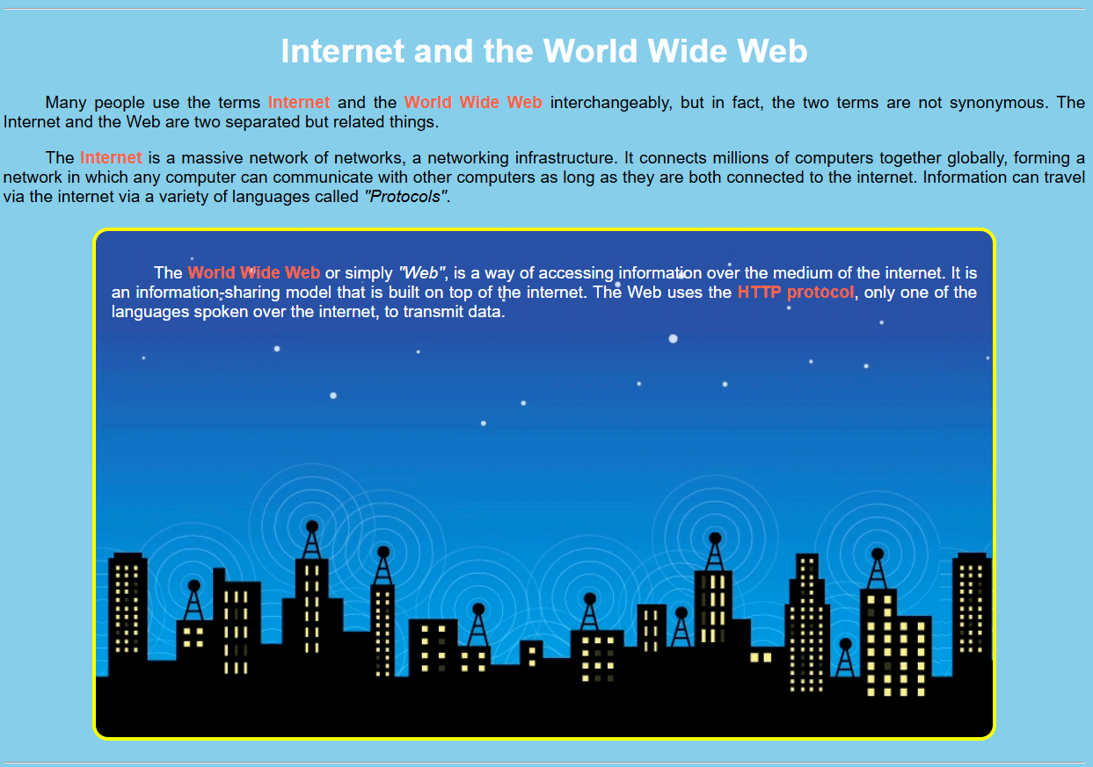
Output

Slide 62

thank you

